Slide 1

3D Printer Filament Making System By Plastic Waste
A
Project on
(STAGE 3 PROJECT REVIEW)
Student Name: Roll No.
Harshad H. Deshmukh 11
Atharva P. Kanakdande 27
Vinayak A. Sonawale 72
Under Guidance of Prof. Shishupal D. Yelgatte Sir
NBN Sinhgad Technical Institute Campus
2023-2024 Sem VII

Slide 2
INTRODUCTION
The world is producing more and more plastic, but only a small fraction of it is recycled. The rest ends up in landfills or incinerators, polluting the environment and contributing to climate change.
One way to reduce plastic waste is to convert it into 3D printer filament. 3D printer filament is a thin, thermoplastic wire used to create 3D printed objects. By recycling plastic waste into filament, we can create a new and valuable product from something that would otherwise be discarded.
Picture it as the "ink" for your 3D printer, usually made from different plastics. Today, we’ll search into the process of turning waste into filament, a 3D printing revolution that's shaping the future of technology while positively impacting the environment.

Slide 3
PROBLEM STATEMENT
High cost: Many existing systems are expensive to purchase and build.
Complexity: Many existing systems are complex to assemble and operate.
Lack of automation: Many existing systems require a lot of manual intervention, which can be time-consuming and error-prone.
Limited compatibility: Many existing systems are only compatible with certain types of waste plastic.
Poor performance: Many existing systems produce filament that is of poor quality, either because of inconsistent diameter or because of impurities in the plastic.

Slide 4
COMPONENTS
:- 05 Volt
:- 12 Volt 4kg Torque
:- 12 Volt
:- 12 Volt
:- 12 Volt 5 Amp
:- 12 Volt
:- 12 Volt
:- 12 Volt
Arduino
Stepper Motor
Cooling Fan
DC Motor
SMPS
Stepper Motor Driver
DC Motor Driver
Temperature Sensor

Slide 5
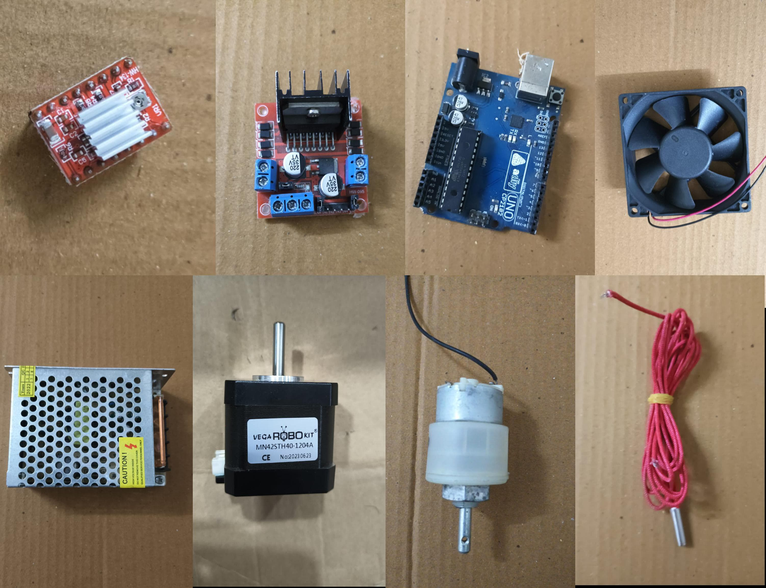

Slide 6
OBJECTIVE & SCOPE
OBJECTIVE :
This project aims to design and develop an Arduino-based 3D printer filament-making system to produce filaments of varying diameters and materials, including PLA, ABS, and PETG.
The system will contribute to sustainable 3D printing practices by reducing the need for virgin plastic filament.
Additionally, the project will explore the process of converting waste plastic into 3D printer filament, further reducing plastic waste and creating valuable, eco-friendly products.

Slide 7
Scope:
The project will cover the following aspects:-
Design and development of an Arduino-based 3D printer filament-making system.
Evaluation of the system's ability to produce filaments of varying diameters and materials.
Exploration of the process of converting waste plastic into 3D printer filament.
Assessment of the system's potential to contribute to sustainable 3D printing practices.

Slide 8
REQUIRED COMPONENT
Arduino microcontroller (any Arduino board will work)
Stepper motor (to drive the extruder)
Stepper motor controller (e.g., DRV8825)
Temperature sensor (e.g., PT100 or K-type thermocouple)
Heater (e.g., cartridge heater or band heater)
Power supply (to power the heater and stepper motor)
Extruder nozzle (the size of the nozzle will depend on the filament diameter you want to produce)
Filament spool holder
Filament guide.

Slide 9
METHODOLOGY
To address these problems, the following improvements can be made to an existing 3D printer filament making system using an Arduino microcontroller:
Use two stepper motors to drive the extruder: One stepper motor can be used to control the speed of the filament extrusion, while the other stepper motor can be used to control the tension in the filament. This will help to produce a more consistent filament diameter.
Use multiple temperature sensors to monitor the melt temperature: One temperature sensor can be placed at the nozzle, while another temperature sensor can be placed in the melt chamber. This will help to ensure that the melt temperature is controlled accurately throughout the extrusion process.
Use a feedback loop to control the heater power: The Arduino microcontroller can be used to read the temperature sensors and adjust the power to the heater accordingly. This will help to maintain a consistent melt temperature and produce a higher quality filament.

Slide 10
BLOCK DIAGRAM/ ARCHITECTURE
Dc motor
Power supply
Aduino
Stepper motor
driver
Bottle cutting mechanism
Stepper motor
Cooling fan
heater

Slide 11
Advantages
Environmental Benefits: Recycling waste plastic into filament reduces the amount of plastic waste in landfills and contributes to a more sustainable and eco-friendly 3D printing process.
Cost-Effective: Creating filament from waste plastic can be a cost-effective alternative to purchasing new filament, making 3D printing more affordable.
Customization: You can control the quality, color, and properties of the filament, allowing for customization to suit your specific 3D printing needs.
Reduced Dependency on New Resources: Using waste plastic reduces the need for new plastic resources, conserving raw materials and energy.

Slide 12
Disadvantages
Equipment and Skill Requirements: The process requires specialized equipment, such as a filament extruder, and some technical knowledge to set up and maintain the system.
Technology Maturity: The technology for 3D printer filament-making from plastic waste is still evolving. Early adoption may involve working with less mature processes and equipment.

Slide 13
References
Development of 3D Printing Filament from Recycled High-Density Polyethylene and Evaluation of Mechanical Properties" Authors: N. Zeydan, et al. Journal: Polymers Year: 2020
Recycling of plastic waste into 3D printing filament" Authors: A. Tiwari, et al. Journal: Resources, Conservation and Recycling Year: 2019
Sustainable 3D Printing Filaments: A Review Authors: M. Parandoush, et al. Journal: Polymers Year: 2019
Anderson I (2017) Mechanical properties of specimens 3D printed withvirgin and recycled polylactic acid. 3D Print Addit Manuf 4:110–115. https://doi.org/10.1089/3dp.2016.0054
Andersson T, Stålbom B, Wesslén B (2004) Degradation of polyethyleneduring extrusion. II. Degradation of low-density polyethylene, linearlowdensity polyethylene, and high-density polyethylene in film extrusion. J Appl Polym Sci 91:1525–1537. https://doi.org/10.1002/app.13024
Badia JD, Strömberg E, Karlsson S, Ribes-Greus A (2012) Materialvalorisation of amorphous polylactide. Influence of thermomechanical degradation on the morphology, segmental dynamics,thermal and mechanical performance. Polym Degrad Stab 97:670–678. https://doi.org/10.1016/j.polymdegradstab.2011.12.019
Baechler C, Devuono M, Pearce JM (2013) Distributed recycling ofwaste polymer into RepRap feedstock. Rapid Prototyp J 19:118–125. https://doi.org/10.1108/13552541311302978
Beltrán FR, Lorenzo V, de la Orden MU, Martínez-Urreaga J (2016)Effect of different mechanical recycling processes on the hydrolyticdegradation of poly(L-lactic acid). Polym Degrad Stab 133:339–348. https://doi.org/10.1016/j.polymdegradstab.2016.09.018
Beltrán FR, Lorenzo V, Acosta J, de la Orden MU, Martínez Urreaga J2018) Effect of simulated mechanical recycling processes on thestructure and properties of poly(lactic acid). J Environ Manag 216:25–31. https://doi.org/10.1016/j.jenvman.2017.05.020
NBN Sinhgad Technical Institute Campus
2023-2024 Sem VII

Slide 14
THANK YOU

